Slide 1
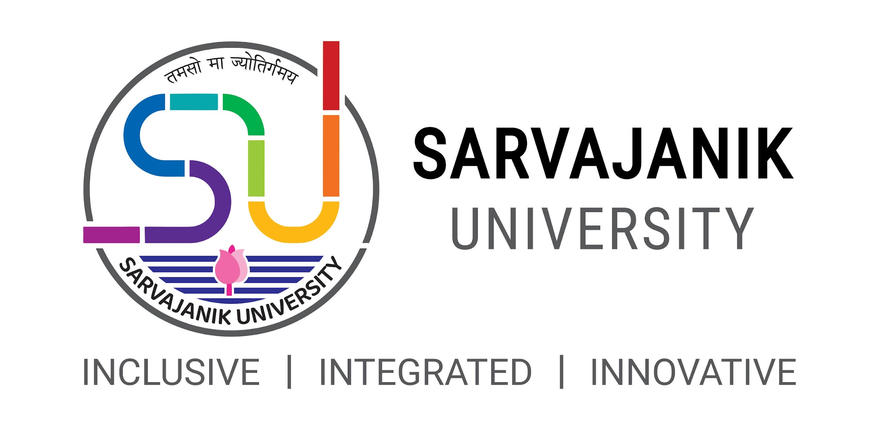
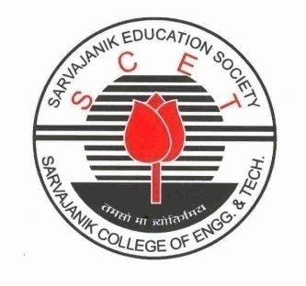
Sarvajanik Education Society Sarvajanik College of Engineering & Technology, Surat. Master of Computer Applications Academic Year: 2023– 24
A Project On
“Student Management System”
Presented By
JHA SHUBHAMKUMAR (ET23MTCA020)
SHAH RUCHITKUMAR (ET23MTCA060)
SOLANKI KHUSHALKUMAR (ET23MTCA062)
M.C.A. I Sem. 1
Under the Guidance of
Prof. Preksha Parmar

Slide 2
Agenda
Project Abstract Objective System Description (Technology Used) Diagram (Use Case Diagram, Activity Diagram) Screen Shorts Advantages & Limitations References

Slide 3
Project Abstract
Student Management System is application developed for managing student data in school, colleges and institutes. In this system admin is super user who can manage all operations like Manage course, manage Student, Generate login ID & Password ,fees Payment etc. The system provides a platform for teacher and student to view their information in the system.

Slide 4
Objective
Main Objective of the Student Management System is to go with computerized system, instead of old fashioned manual process. As compared to old process this system help to increase Sustainability. In this system admin is super user who can manage all operations related to teacher and students.

Slide 5
System Description
Software Requirement | Dev C++, Turbo C
Hardware requirements | Processor : Minimum 2 GHz Hard Drive : Minimum 64 GB or More Memory : 4 GB or Above
Operating System | Windows 7 or Above

Slide 6
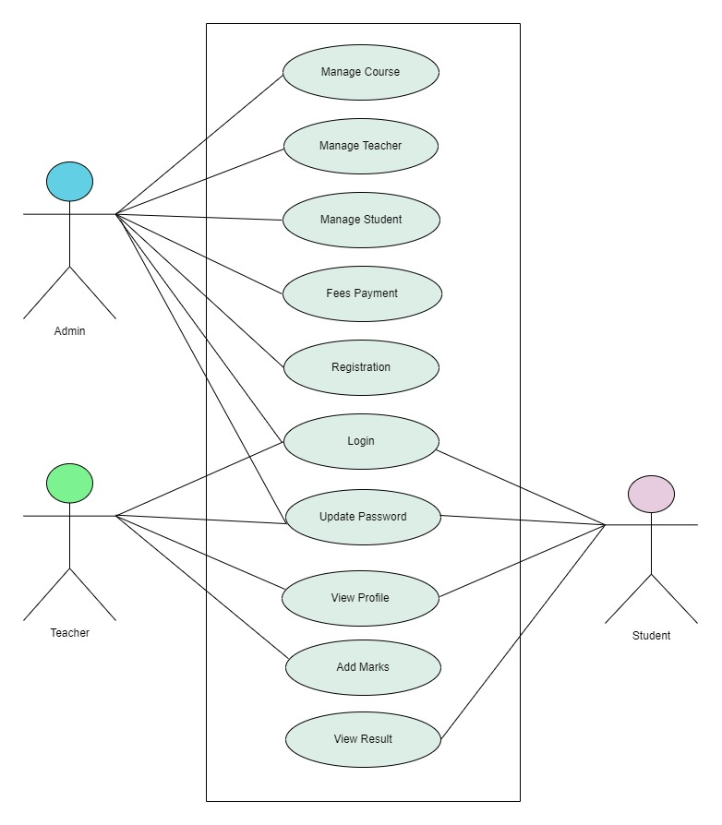
Use Case Diagram

Slide 7
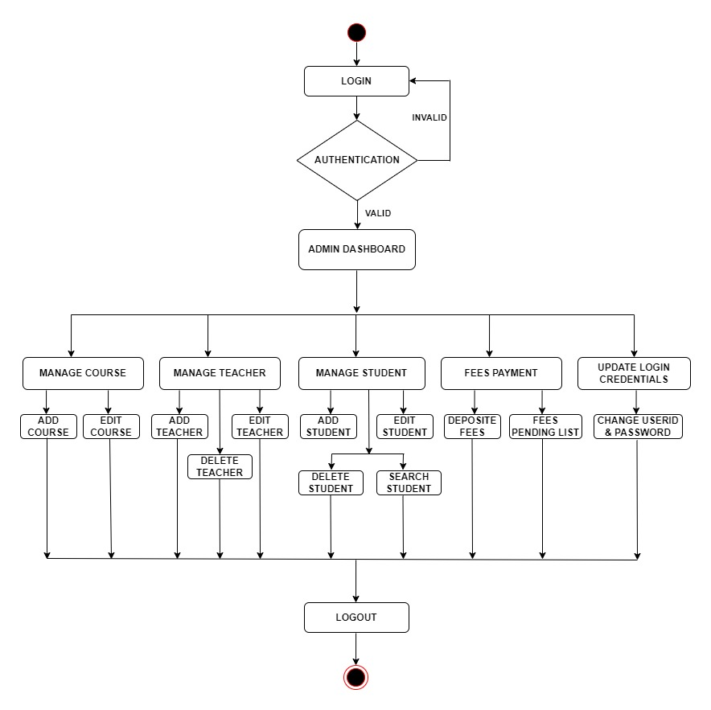
Activity Diagram (Admin)

Slide 8
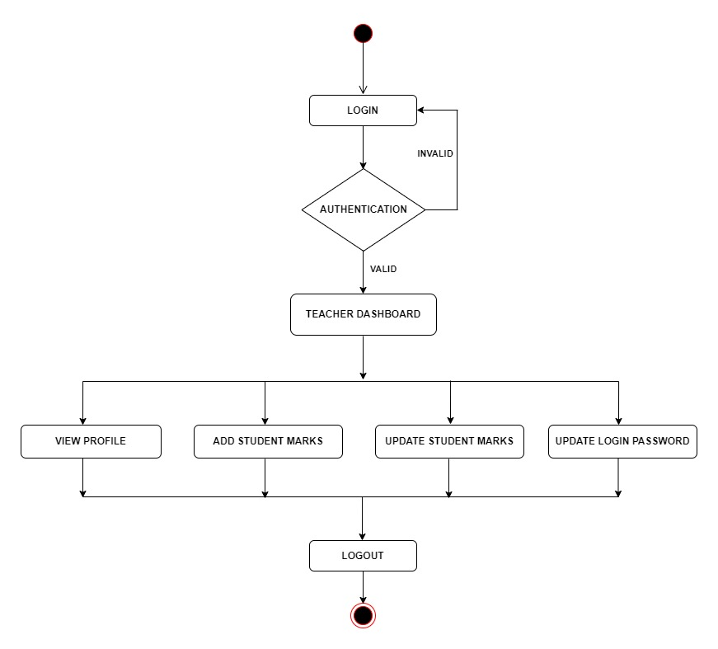
Activity Diagram (Teacher)

Slide 9
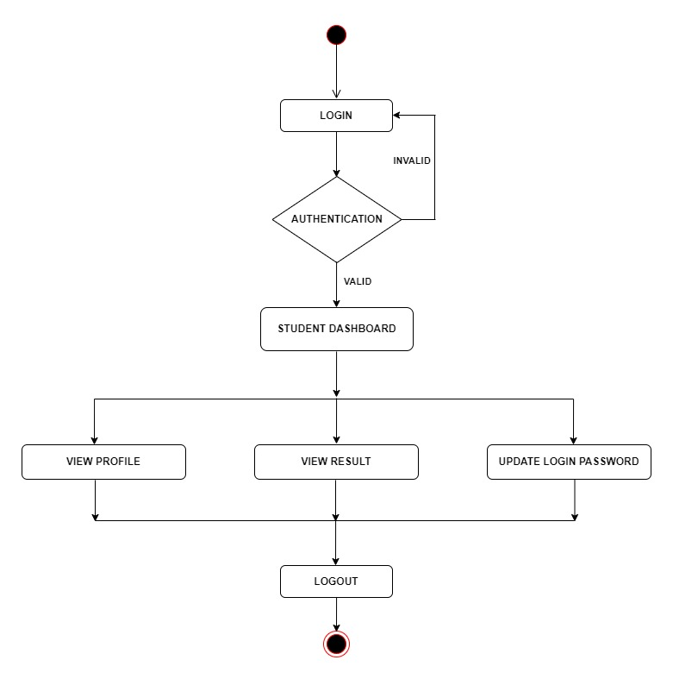
Activity Diagram (Student)

Slide 10
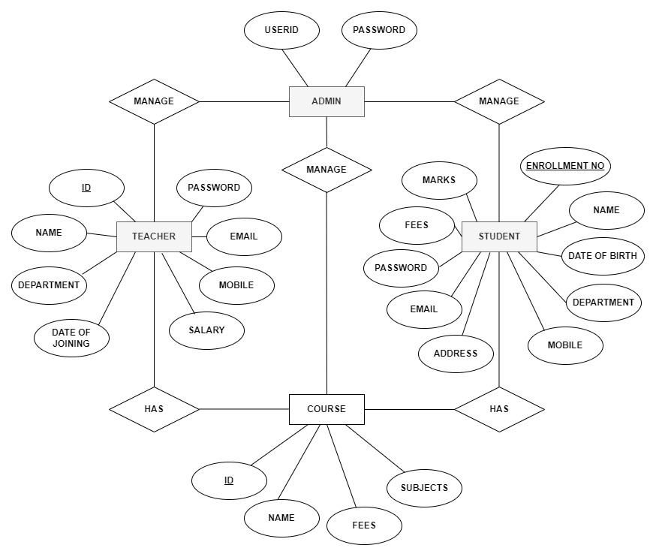
E-R Diagram

Slide 11
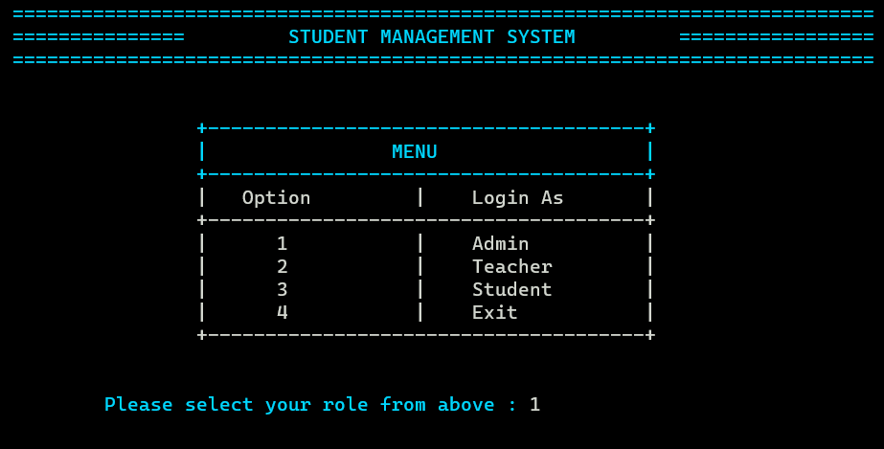
Screen Shorts

Slide 12
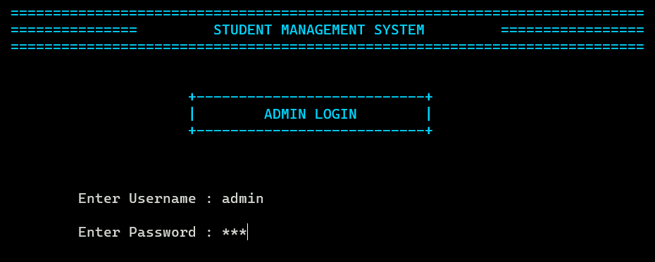
Screen Shorts

Slide 13
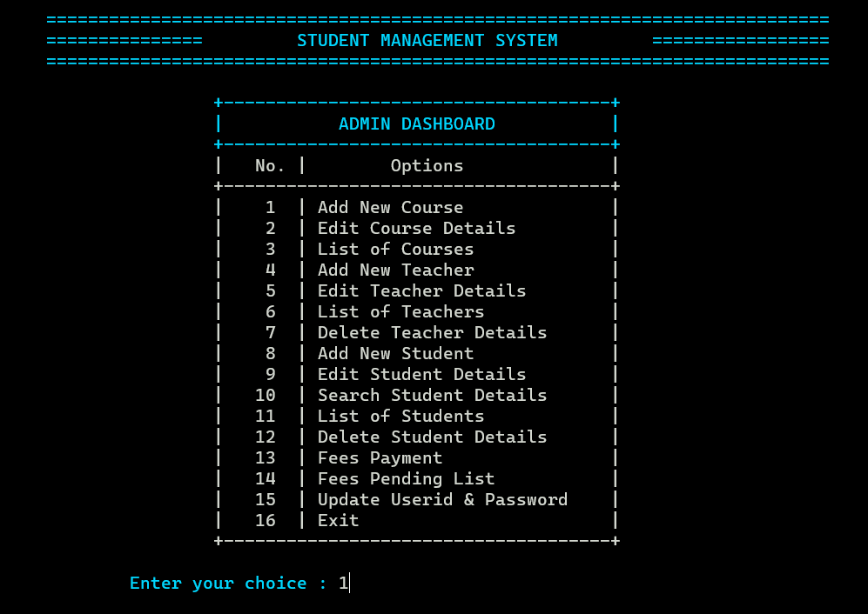
Screen Shorts

Slide 14
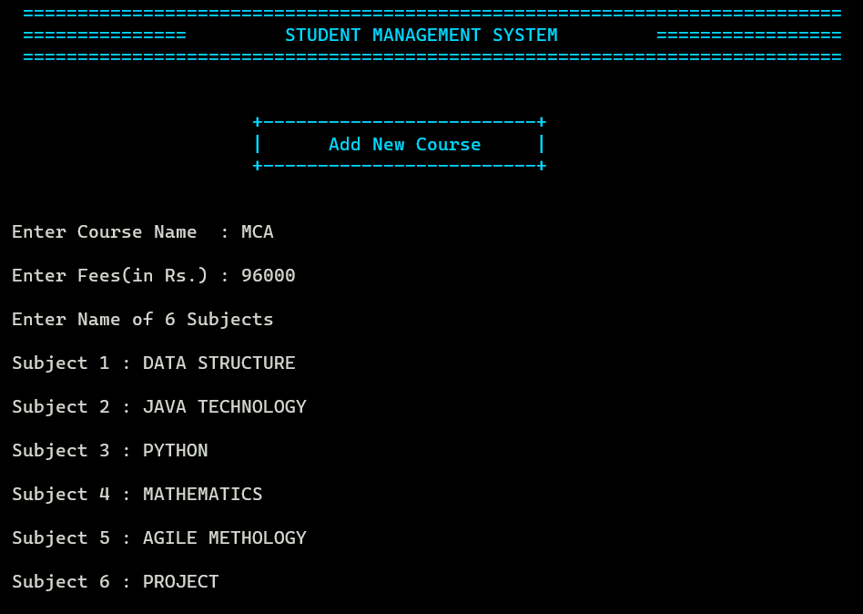
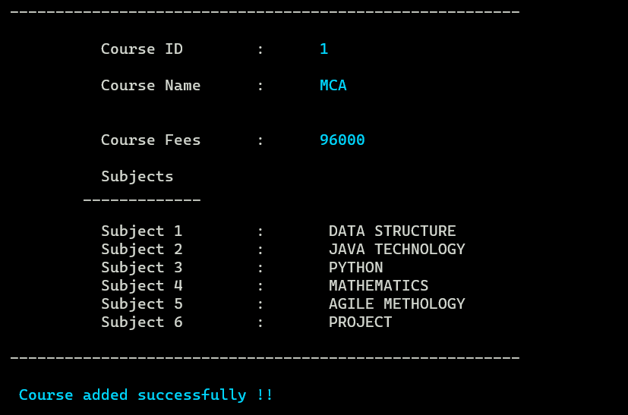
Screen Shorts

Slide 15
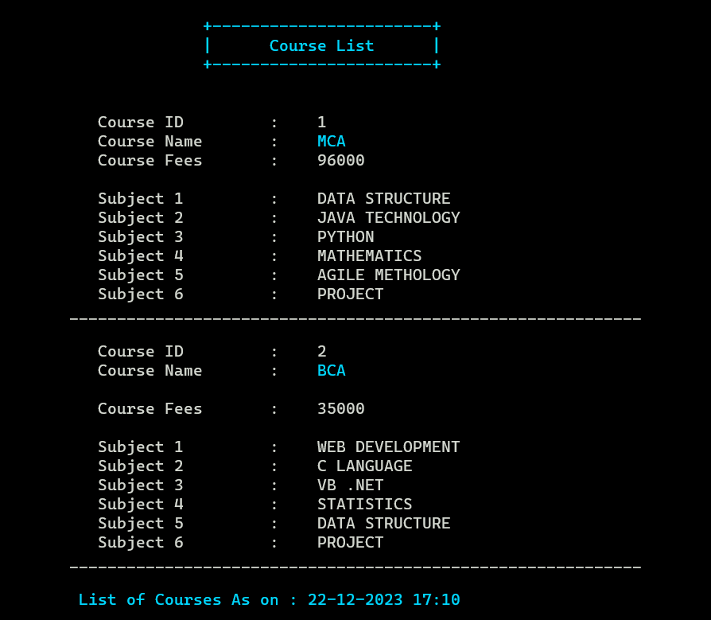
Screen Shorts

Slide 16
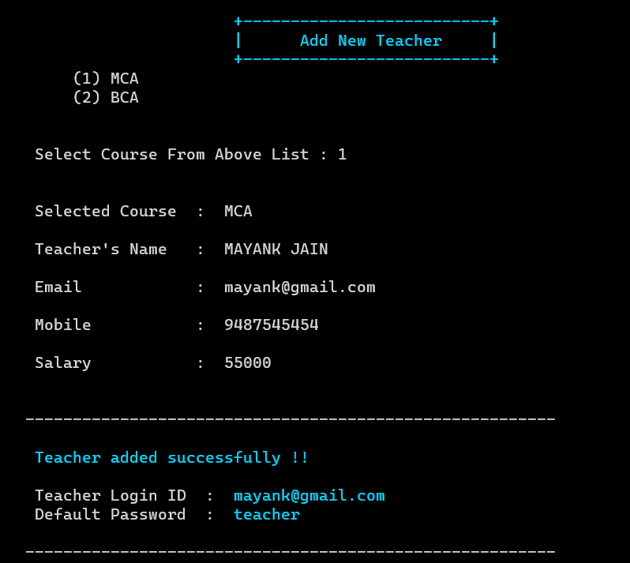
Screen Shorts

Slide 17
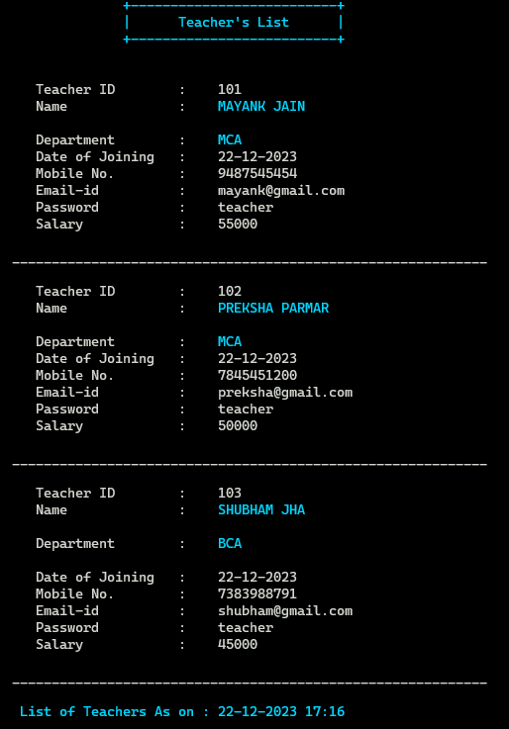
Screen Shorts

Slide 18
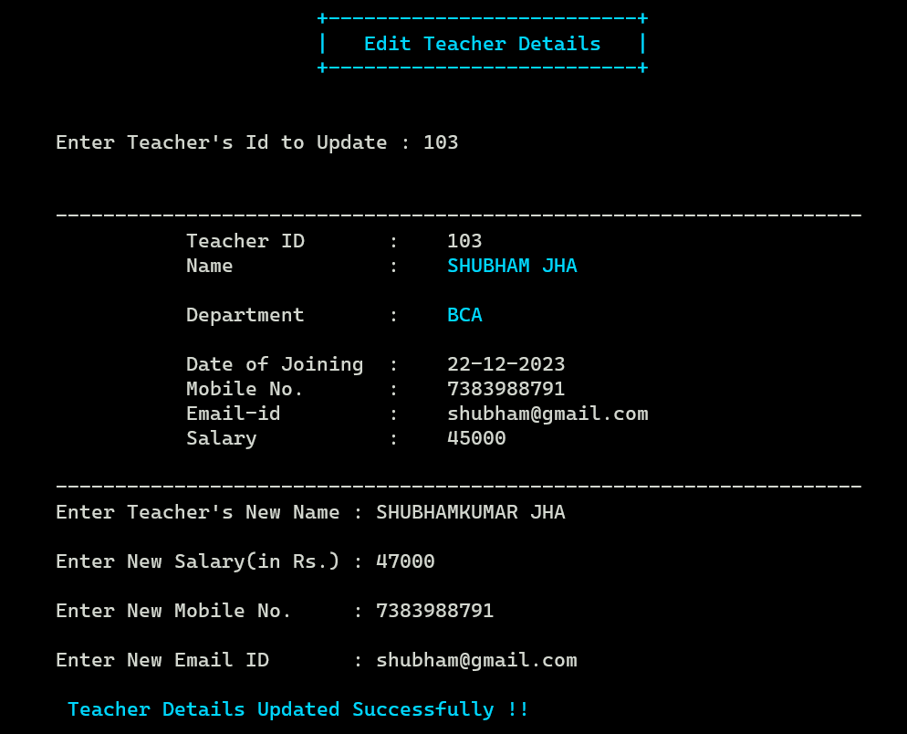
Screen Shorts

Slide 19
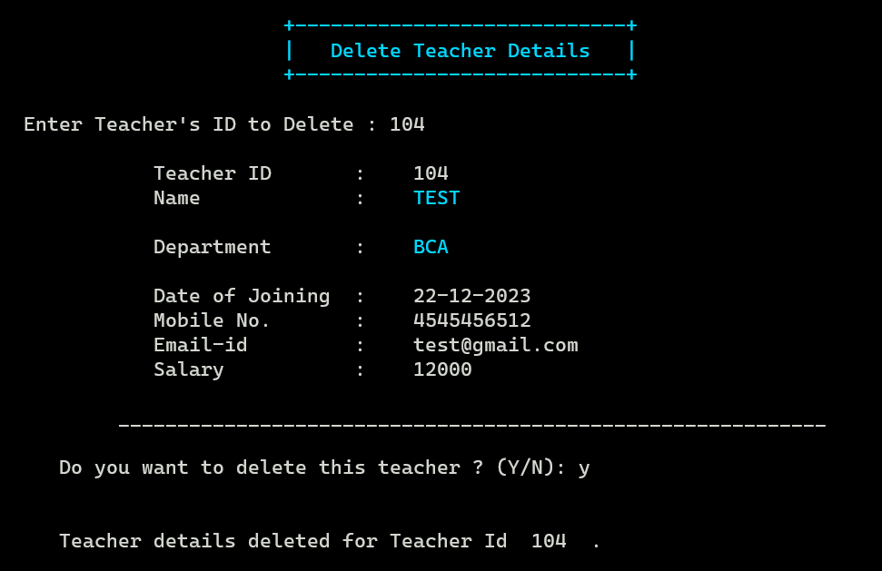
Screen Shorts

Slide 20
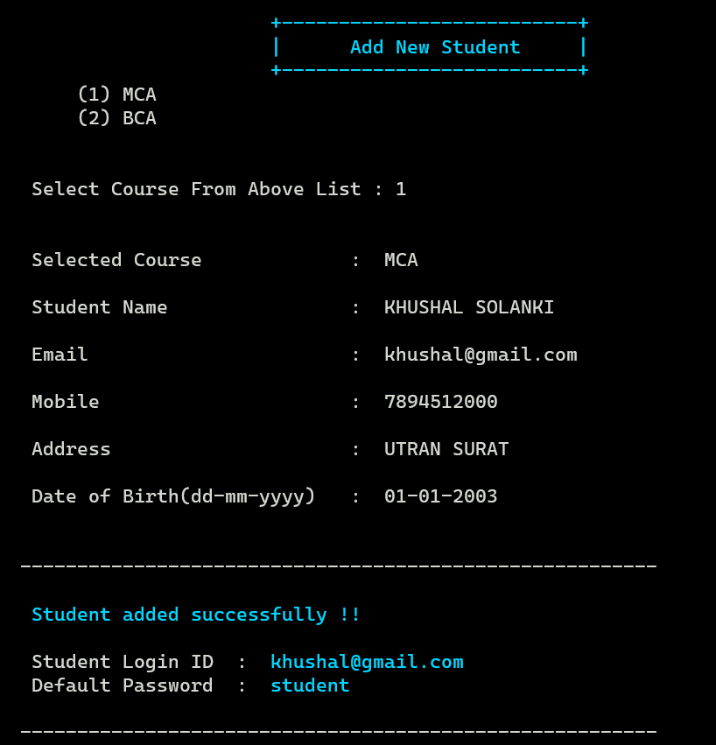
Screen Shorts

Slide 21
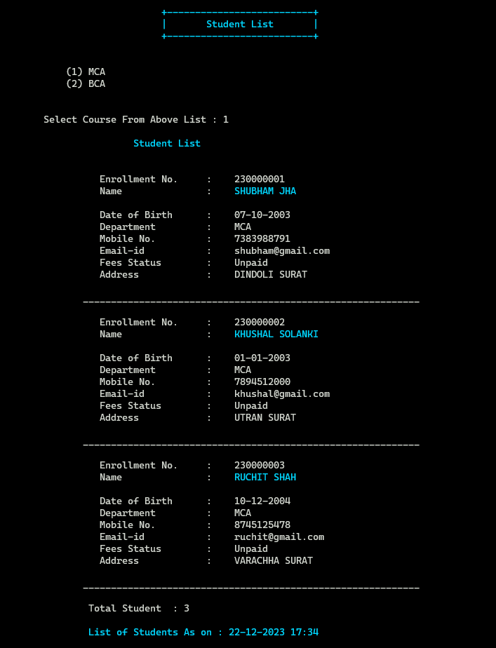
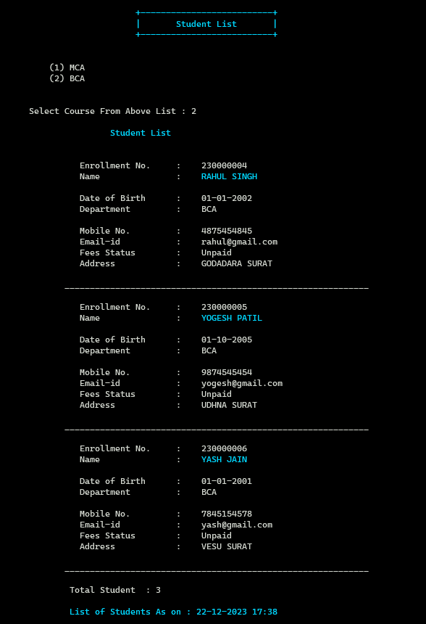
Screen Shorts

Slide 22
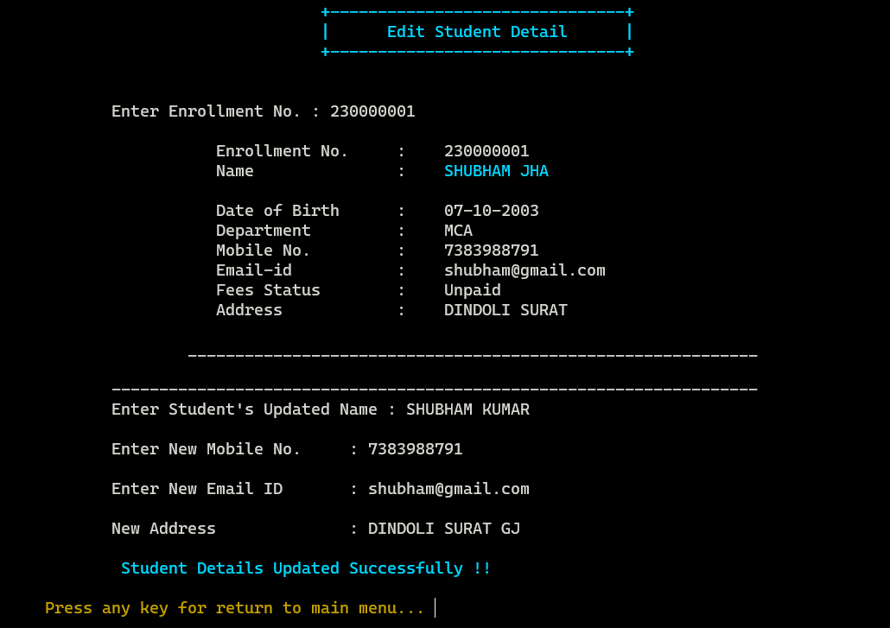
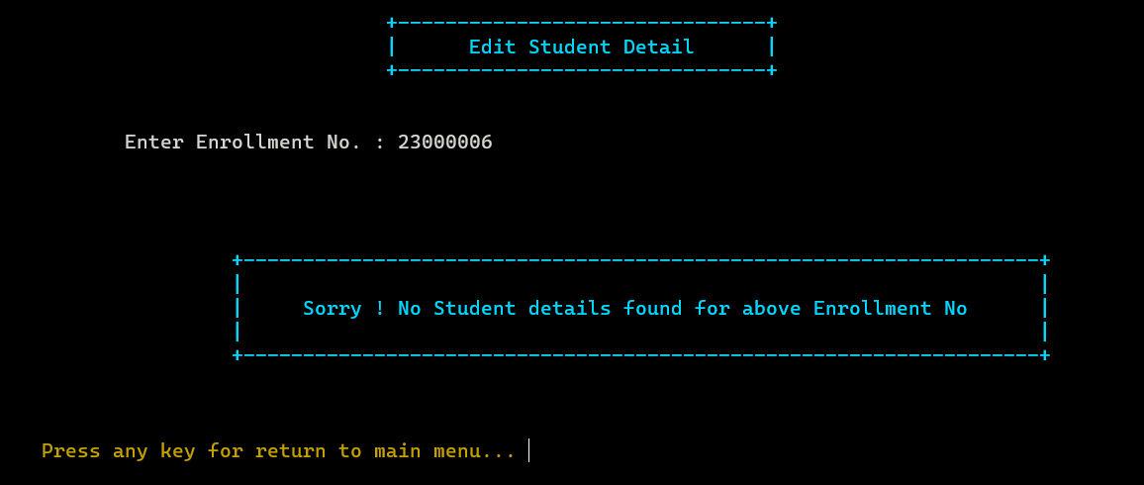
Screen Shorts

Slide 23
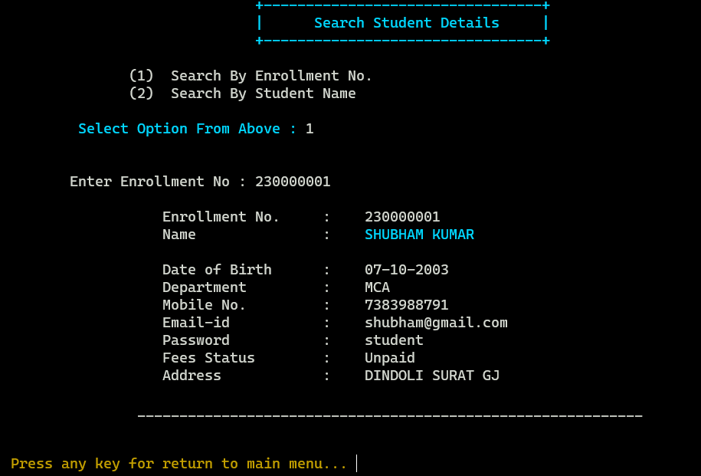
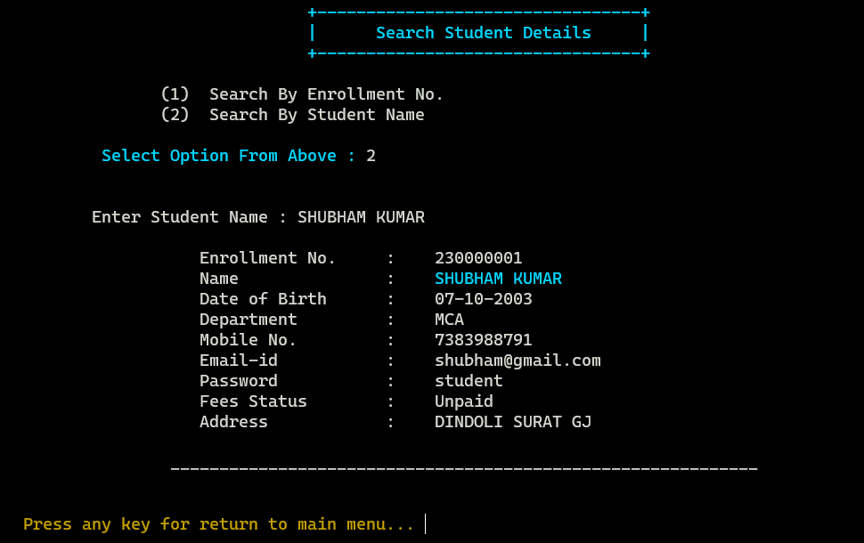
Screen Shorts

Slide 24
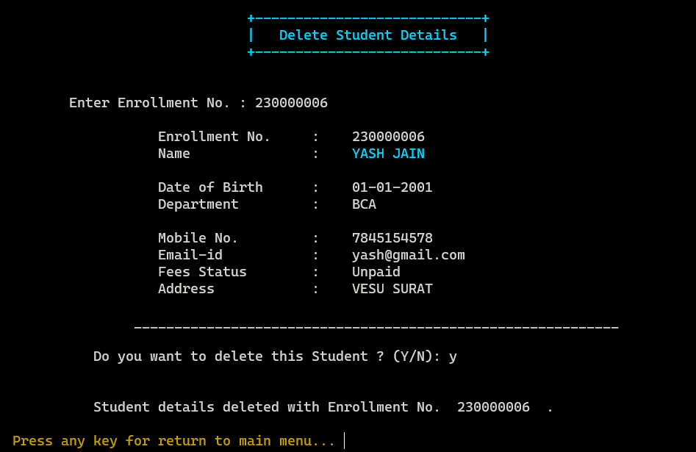
Screen Shorts

Slide 25
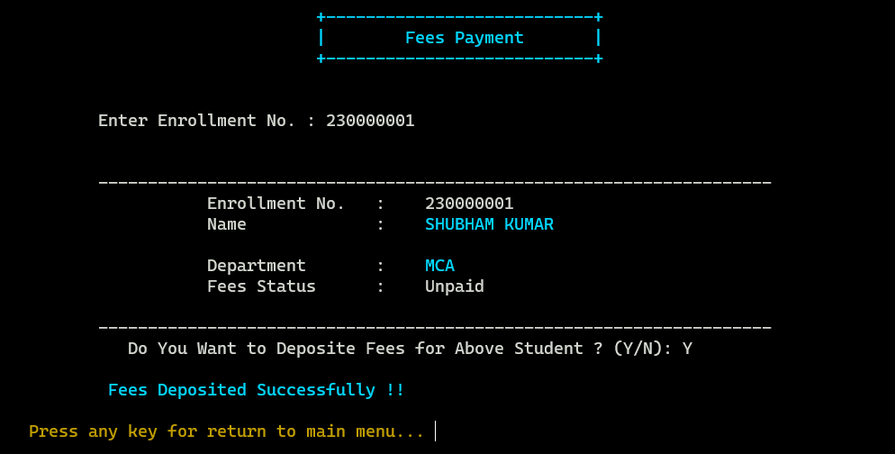
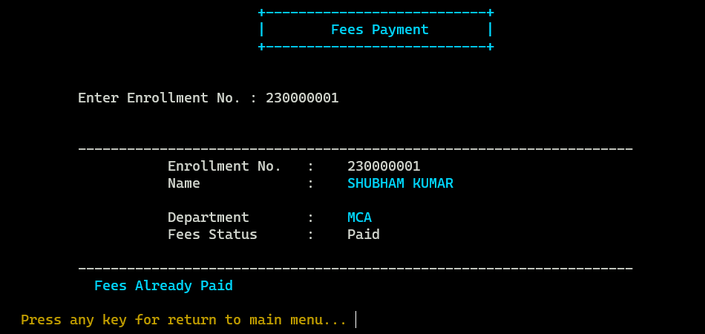
Screen Shorts

Slide 26
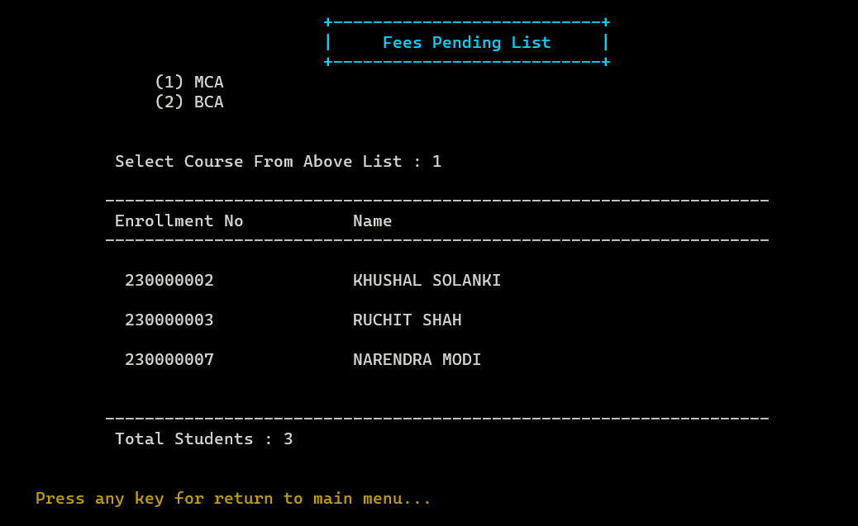
Screen Shorts

Slide 27
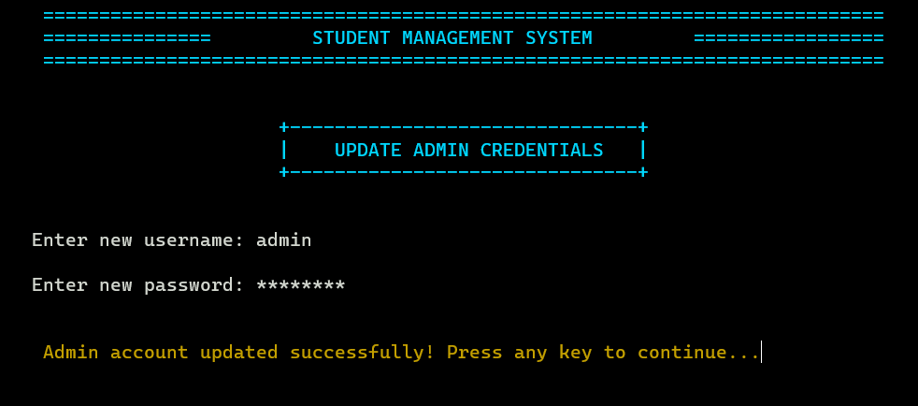
Screen Shorts

Slide 28
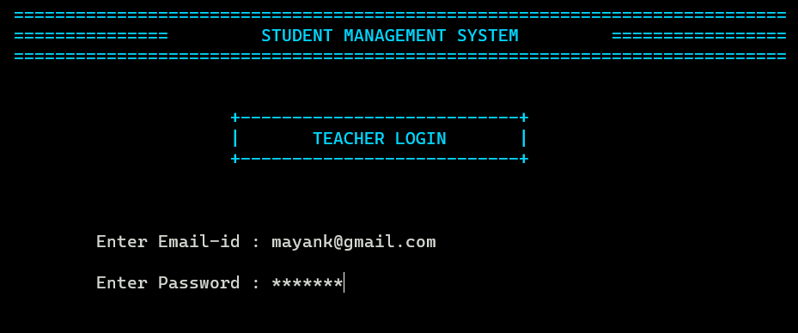
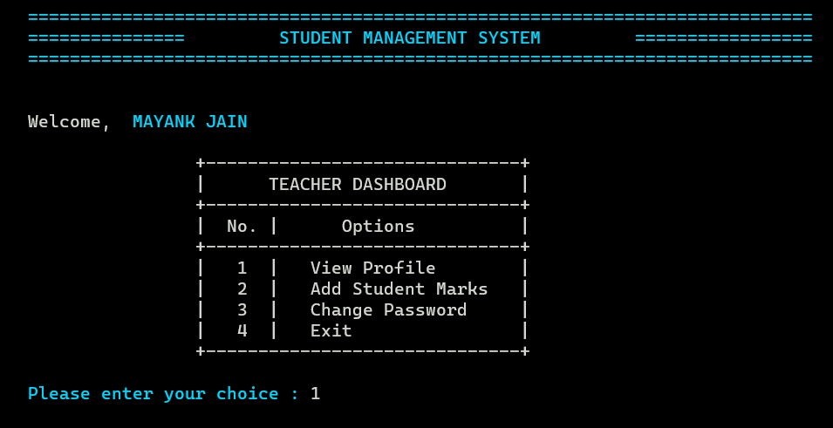
Screen Shorts

Slide 29
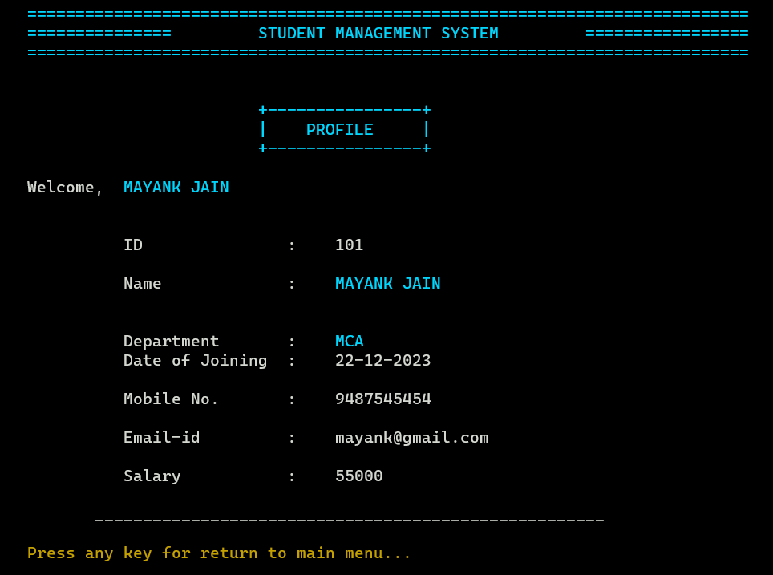
Screen Shorts

Slide 30
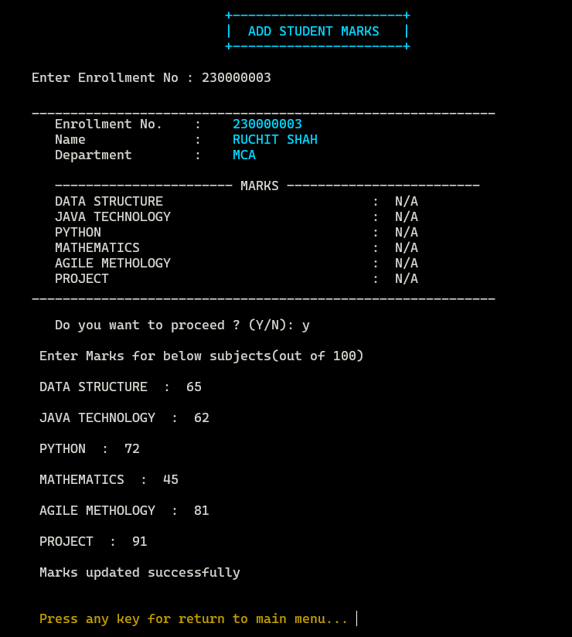
Screen Shorts

Slide 31
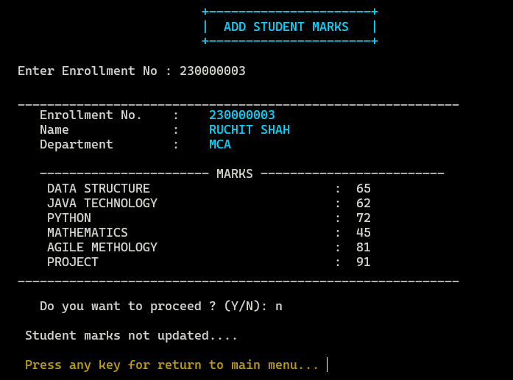
Screen Shorts

Slide 32
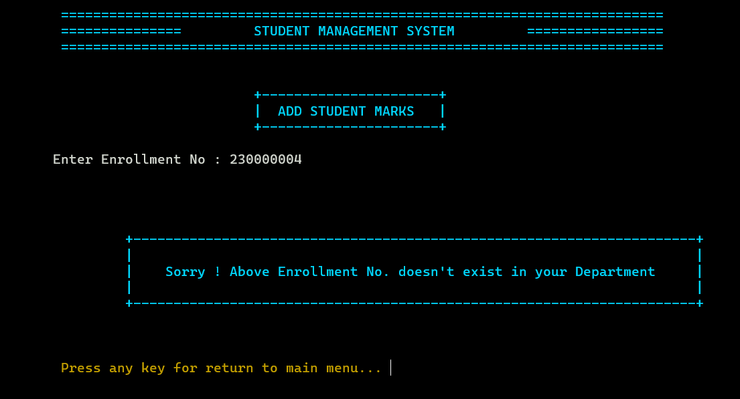
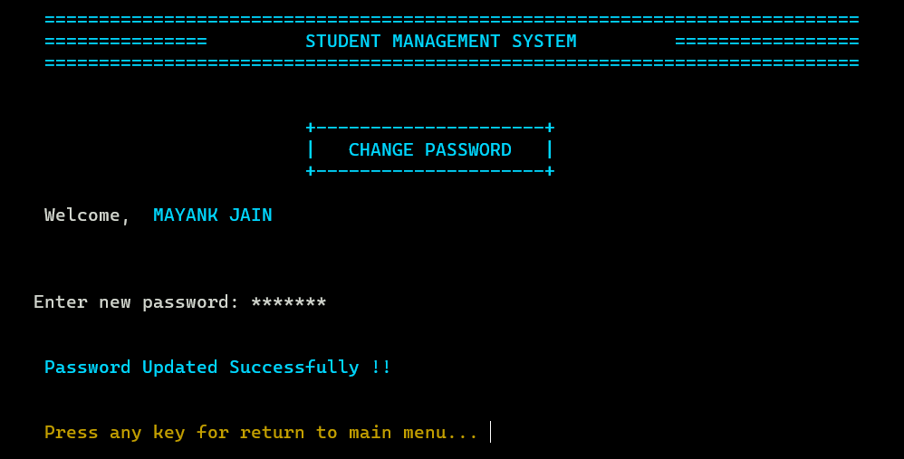
Screen Shorts

Slide 33
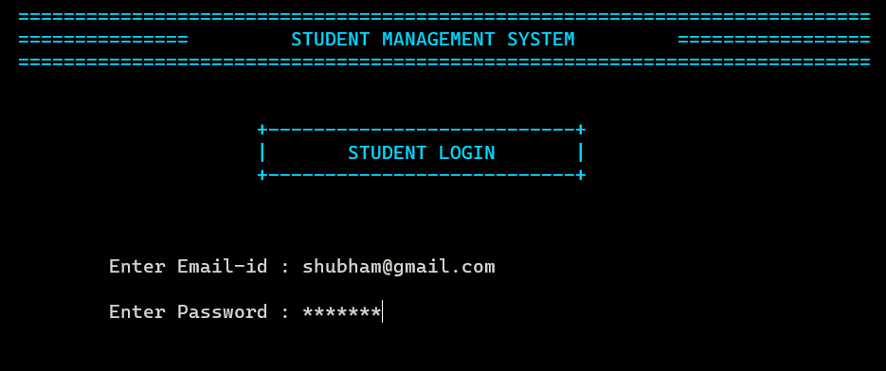
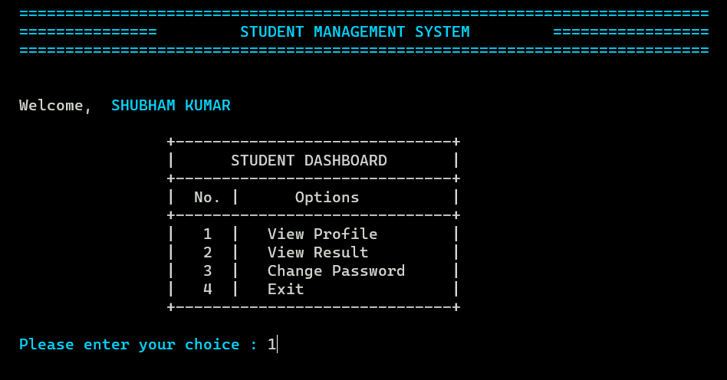
Screen Shorts

Slide 34
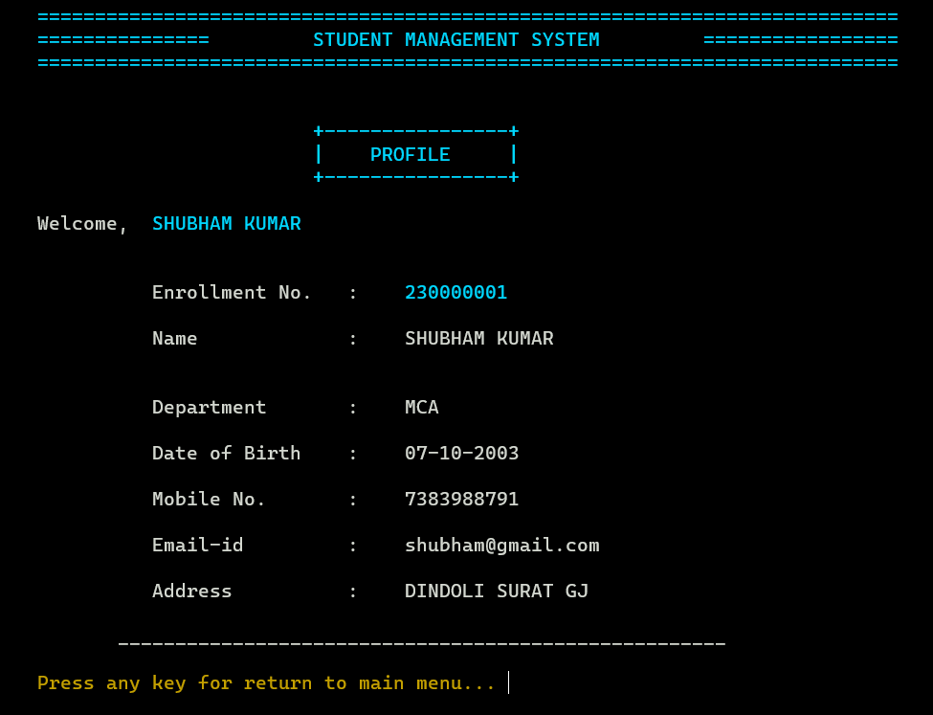
Screen Shorts

Slide 35
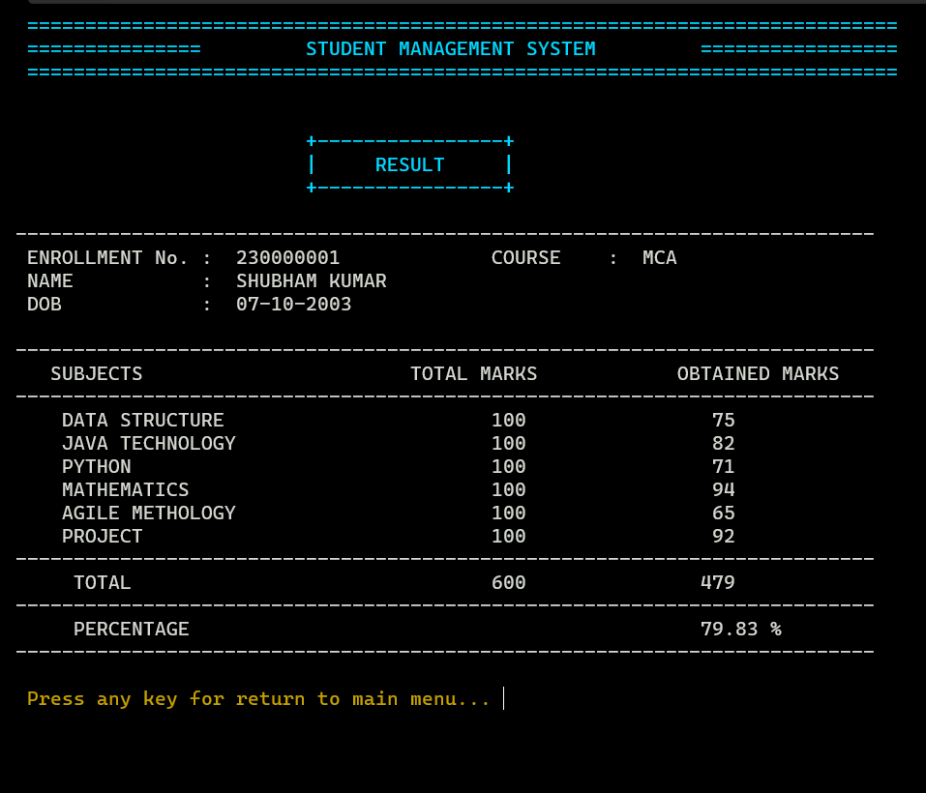
Screen Shorts

Slide 36
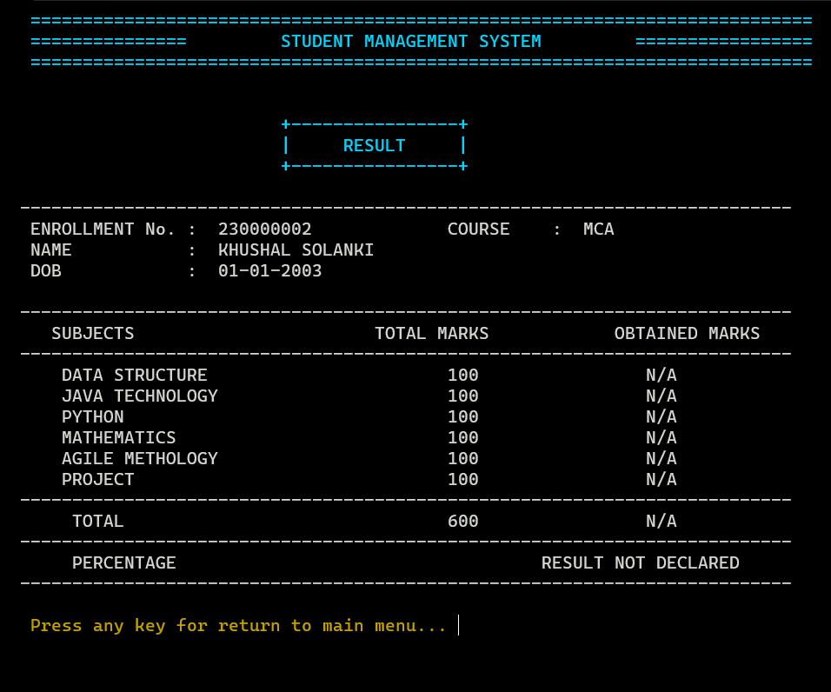
Screen Shorts

Slide 37
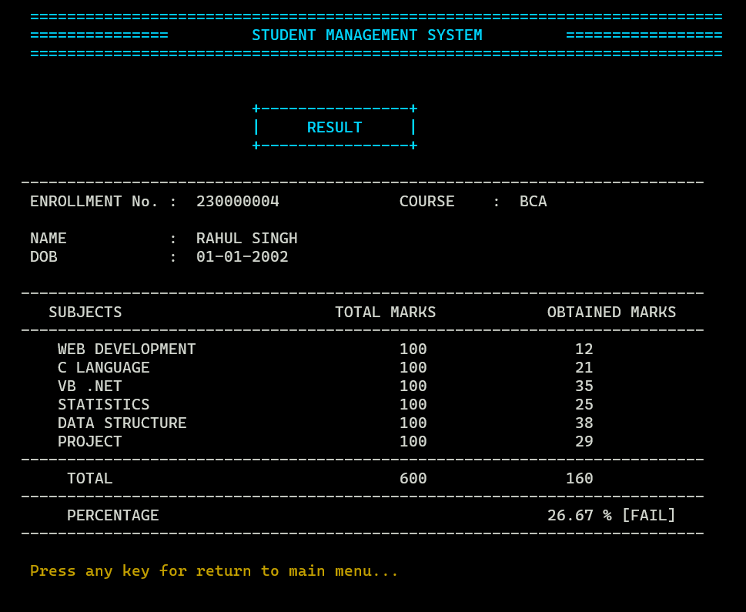
Screen Shorts

Slide 38
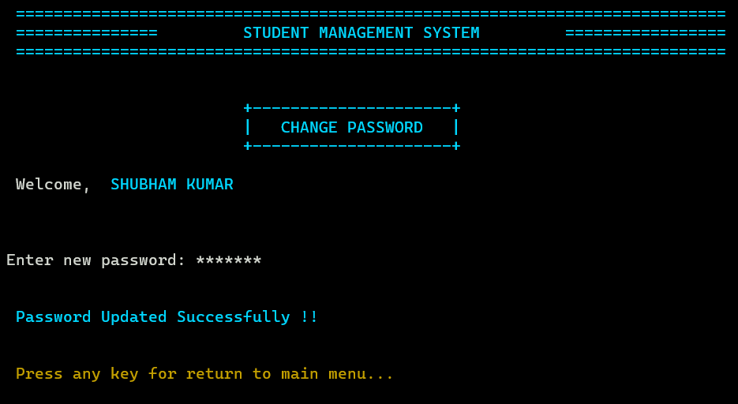
Screen Shorts

Slide 39
Advantages
Time and Cost Savings: : Reduces the time and costs associated with manual record-keeping and administrative tasks, allowing institutions to allocate resources more efficiently. Efficient Grade Management : In this system student can easily view their marks by login and password which is updated by teachers or faculties. Improved Accessibility: Provides easy access to information for all admin, allowing faculties and students to track any changes like profile, marks etc.

Slide 40
Limitations
User-Interface : Complex-user interface may lead to increased difficulty in acceptance of the student management application among the institute staff. User Authentication and Authorization : Implementing robust user authentication and authorization mechanisms is essential. If not properly implemented, there is a risk of unauthorized access to sensitive information. Scalability Issues: As the student management system grows and the amount of data increases, managing scalability can be challenging, especially without automatic memory management.

Slide 41
References
https://www.cprogramming.com/ https://www.w3schools.com/c/index.php https://www.geeksforgeeks.org/c-programming-language/

Slide 42
Thank You

